Slide 1
Enabling Affordability for Inclusive Development
Alliance for Affordable Internet (A4AI)
a4ai.org
@a4a_internet

Slide 2
What is A4AI?
We are the
world’s broadest technology sector alliance working to
drive down the price of broadband
by
transforming policy and regulatory frameworks.

Slide 3
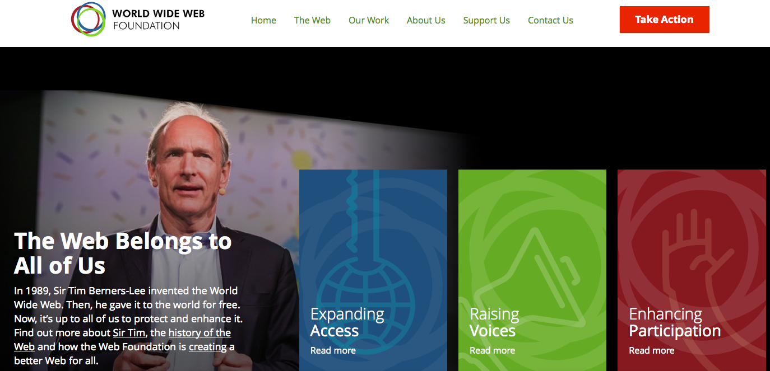
Hosted at the Web Foundation
Notes:
All of the internet, for all of the people, all of the time: the Web Foundation works for universal access to an open Web in order to defeat poverty, democratise knowledge and give everyone a voice.
Access: Almost 60% of the world’s people have no access to the life-changing potential of the Web. We want to change that. A4AI
Voice: We’re fighting for everyone’s rights to create, share knowledge, and express their opinions online. WRO, WebWeWant and WebIndex
Participation: We’re using the Web to strengthen democracy, by empowering people to use data for accountability and civic innovation. Open Data Program (Charter, Labs, OGP, ODB, etc). Michael can add here or during Q/A on OD specifics

Slide 4
A global multi-stakeholder coalition
80 members from across the private, public & non-profit sectors
Member organisations come from developed & emerging countries
Particular focus on local partners based and working on the ground in countries of engagement (currently close to 250 partners across the countries)
Notes:
Global sponsors include Google, USAID
Other members include: Facebook, Cisco, Ericsson, Internet Society, Mercy Corps, World Pulse, UN Women, Countries of engagement plus Sweden.

Slide 5
Aligned around policy and regulatory best practices
All member organisations have endorsed a set of nine best practices
Aim to ensure open, competitive markets
Policies & regulations needed in place to lower cost structure for the industry
Grounded on principles of Internet freedom & the fundamental rights of expression, assembly, and association online

Slide 6
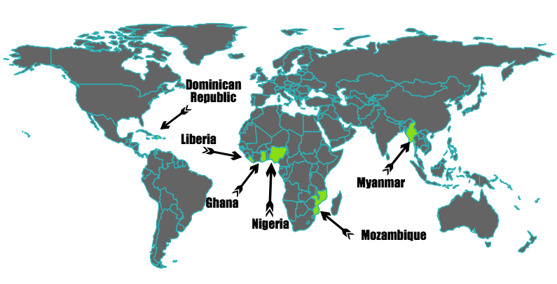
Direct support & action: Where are we working?

Slide 7
How do we work in member countries?
In each member country, we form a
national multi-stakeholder coalition

⬆

civil society
public sector
private sector
to
identify key barriers to affordable access
&
devise tailored solutions to drive prices down
Notes:
National-level work

Slide 8
Conducting robust original research to underpin evidence-based policy
  Annual Affordability Report
  Newest edition published March 2016
  Case studies
  Thematic briefings
  Universal Access & Service Funds;
  Zero-rating & other mobile data plans
  Ghana, Nigeria, Cameroon, Peru, Brazil, Dominican Republic, Myanmar, Bangladesh
Notes:
Research includes a number of countries beyond countries of engagement:
- Mob. Data plans: Ghana, Kenya, Nigeria, Bangladesh, Philippines, India, Colombia, and Peru

Slide 9
International advocacy through
global partnerships
Working together to expand access & achieve the SDGs
Operationalizing recommendations from the 2016 WDR report to close the digital divide & expand digital dividends (World Bank)
Building capacity to develop strong ICT & gender policy (ECOWAS, CRASA & other regional organizations)
Advocate for gender responsive policy and better & improved gender data and indicators (UN-Women, GSMA)
September 2016: Inaugural event! Unlocking Africa’s Digital Future: Women & Girls in Technology Summit (UN Women, AfDB, AITI-KACE)
Notes:
--------- Please add in text for GSMA work -------

Slide 10

Advancing women’s rights online
New initiative with the Web Foundation’s Women’s Rights Online program & UN Women
Breaking the affordability barrier:
Policies to ensure that inability to pay does not stop anyone from getting online & using full online access in a transformative way
Breaking the gender barrier:
Policies & programs that advance women’s active citizenship and civic participation through technology.
Notes:
Breaking the affordability barrier: Policies that make full access to broadband Internet affordable to all and ensure that inability to pay does not stop anyone from getting online and using that access in a transformative way
Breaking the gender barrier: Policies and programmes that advance women’s active citizenship and civic participation through technology
This includes working closely with on-the-ground partners, advising governments, civil society and private sector stakeholders and A4AI members on how to achieve:
SDG 5b - women’s empowerment through technology;
SDG 9c - universal and affordable access to the Internet in least developed countries by 2020; and
SDG 1.4 - equal rights to economic resources, as well as access to ….appropriate new technology and financial services, including microfinance for all women and men by 2030

Slide 11
What is the state of affordability?
The high cost to connect is excluding
billions from the digital revolution
Over half the world’s population is still offline
111 countries have met the UN affordability target of basic broadband priced at 5% or less of average monthly income
YET
Just
9 countries
meet this target for the bottom 20% of income earners
0 countries
meet this target for those living in poverty
Notes:
9/10 of the offline population is in developing countries
Most are women, rural & poor populations

Slide 12
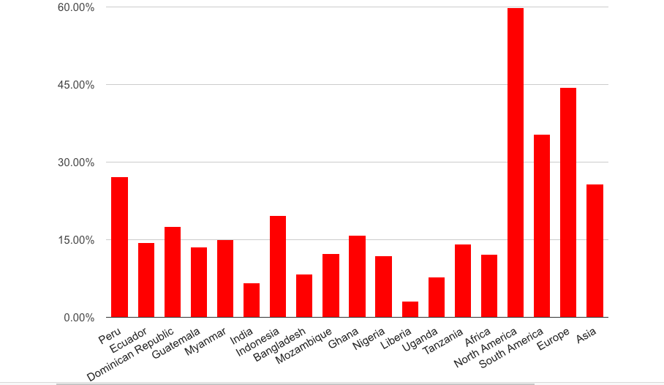
Just how widespread is mobile broadband?
Mobile Broadband Penetration: unique subscribers of Mob. BB (3G, 4G) as a percentage of the population
Source: GSMA Intelligence, Q42015
Notes:
Without access there is no financial inclusion (not possible to access financial services)
If you don’t focus on access policy and clear policy frameworks that support the delivery of services over mobile networks, you won’t get to achieve financial inclusion; Ensure that communications regulators understand their role in facilitating growth of the sector while protecting users/consumers through policy frameworks that ensure data protection, privacy.

Slide 13
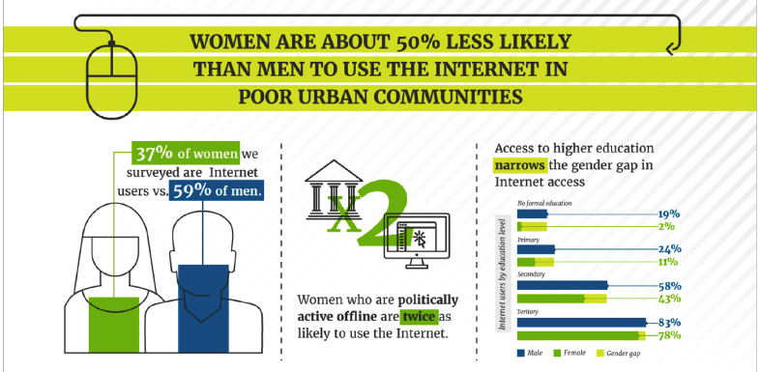
Exploring the true extent of the gender digital divide (WRO, data2X)
Notes:
Women’s Rights Online study (published October 2015) surveyed poor, urban men & women across 9 cities in the developing world to gain a better understanding of their access to and use of the Web
Africa: Uganda, Nigeria, Mozambique, Cameroon
Asia: Philippines, Indonesia, India
LAC: Colombia
MCC has partnered with the Data2x initiative of the UN Foundation and the World Wide Web Foundation to conduct a gender data competition in Côte d’Ivoire, titled TechMousso (mousso means female/mother/woman in Bambara language). Côte d’Ivoire was chosen because it was recently selected by MCC as a country eligible for an MCC Compact, and thus data from the competition could help inform Compact development. In addition, the government of Côte d’Ivoire has shown serious interest and political will around improving the situation of women and girls, and this competition could help strengthen the country’s performance on their MCC score card.
Addition Background info:
Competition Goals
Generate gender data for use in informing the project design of the MCC compact program for Côte d’Ivoire.
Assist Côte d’Ivoire in its work on development of women and girls and achievement of Sustainable Development Goals (SDGs).
Increase the effectiveness of and empower community organizations working with women and girls in Côte d’Ivoire.
Increase demand for and use of gender data.
Support the mission of MCC, the Data2X initiative of the UN Foundation, and the Web Foundation.
Competition Structure:
MCC, Data2X, and the Web Foundation will host a gender data competition in Côte d’Ivoire in April-July, 2016. The competition will convene civil society organizations (CSOs), government ministries, the private sector and the tech community to creatively solve problems using gender data.

Slide 14
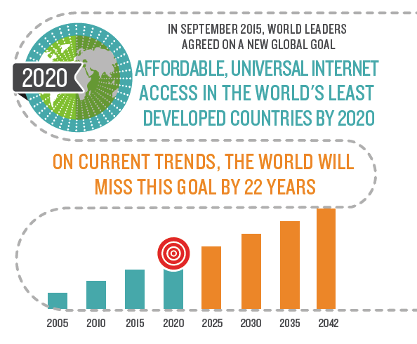
Internet for all by 2020?
Notes:
SDG 9c calls specifically for affordable, universal Internet access in the world’s least developed countries by 2020
Our Affordability Report research shows that unless we take urgent action now to improve affordability & close the gender and poverty gaps in access we’ll miss the UN target by over 20 years
Missing this target will increase the digital and developmental divide, and will undermine global development

Slide 15
What action must we take to make universal access a reality?
Commit to a new “1 for 2” affordability target
1GB of mobile data priced at 2% or less of average monthly income
Prioritise & expand public access initiatives
Critical to bringing connectivity to the most marginalised
Design policies with a gender focus
Closing the digital gender gap will require policies to reduce barriers for women
Notes:
What action must we take to make hitting this ambitious target a possibility?
Commit to a new “1 for 2” target: Our Affordability Report research shows that when a basic broadband package is priced at this level, it becomes affordable for all levels of income earners, including the bottom 20%. Moving the data allowance up to 1GB will encourage more meaningful use of the Internet.
Prioritize public access: Free & subsidized community access enables connectivity for those that continue to be excluded by the market, or who remain unable to afford the cost to connect
Gender-specific/focused policies: Closing the gender digital gap is critical to global development & women’s empowerment; This won’t happen unless policies make a concerted effort to connect women

Slide 16
How is A4AI working to tackle these gaps?
Improving collection of gender- and poverty-disaggregated data to track progress
Encouraging the adoption of ambitious affordability targets to drive down prices & increase access
Working with national coalitions & stakeholders on the ground to develop policies needed to improve affordability
Advocating for expanded public access initiatives
Designing gender-responsive policy
Notes:
What specifically is A4AI doing to tackle the affordability challenge and close the growing digital divide?
Working with governments and international organizations to adopt ambitious new affordability and access targets: Encouraging the political commitment to and investment in
Translate SDG targets 9c, 5b and 1.4 into action, through increased consensus on, gender-disaggregated measurement of, investment in and political commitment to necessary policy changes

Slide 17
National Coalitions: Selected engagement areas
Country | Identified Priority Issues (1st Phase)
Ghana | • Data collection/research to develop solid evidence for policy decisions • Taxation • Infrastructure sharing & open access • Pricing transparency; user awareness of services Win: 20% import tax on smartphones reduced
Nigeria | • Pricing transparency; consumer awareness • Open access framework and infrastructure sharing • Spectrum policy: availability, allocation & innovative uses of free/unlicensed spectrum • Data collection and indicators (M&E) New Minister appointed in November 2015 & joined Coalition meeting NCC has new head
Mozambique | Data collection/research to develop solid evidence base for policy decisions Taxation (submission to reduce import taxes on devices & BB infrastructure inputs) Infrastructure sharing (draft infrastructure sharing regulations being developed) Win: inclusion of ICT indicators in 2017 National Census
Notes:
Spectrum policy: focus on the need for more spectrum, fair allocation and innovative uses, availability of free/unlicensed spectrum
Data collection and indicators – across areas, systematic natl. level effort; fully gender disaggregated and new gender indicators

Slide 18
National Coalitions: Selected engagement areas
Country | Identified Priority Issues (1st Phase)
Dominican Republic | Development of a Digital Agenda Data collection/research to develop solid evidence base for measuring progress toward Digital Agenda goals and & for sound policy decisions Taxation and fiscal policy in general Infrastructure sharing and open access Win: Revived Digital Agenda development process, had been dormant for 5+ years; got the attention of Presidential candidates
Myanmar | Universal Access and Service Fund (first UASF workshop identified options ahead) Open access framework and infrastructure sharing Taxation Data collection and indicators (M&E)
Liberia | Support ICT Policy development with multi-stakeholder approach and policy advice (Draft policy for consultation in March 2016) Targeted approach and advice

Slide 19
Thank you!
Alliance for Affordable Internet
www.a4ai.org
@a4a_internet

